Slide 1
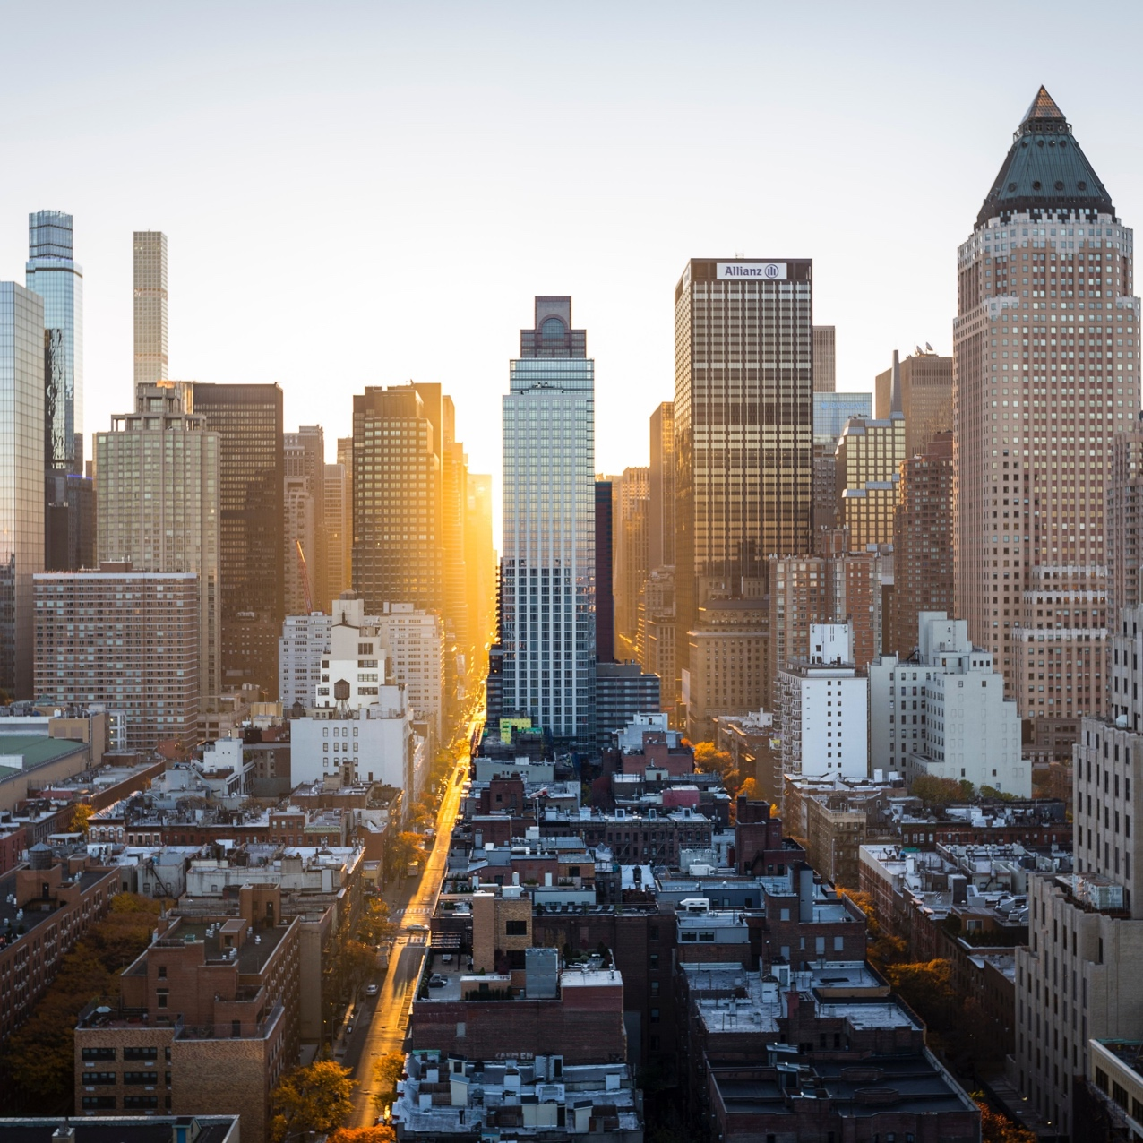
Capstone Project: final Assignment
Best Places in Toronto for travelers using foursquare data

Slide 2
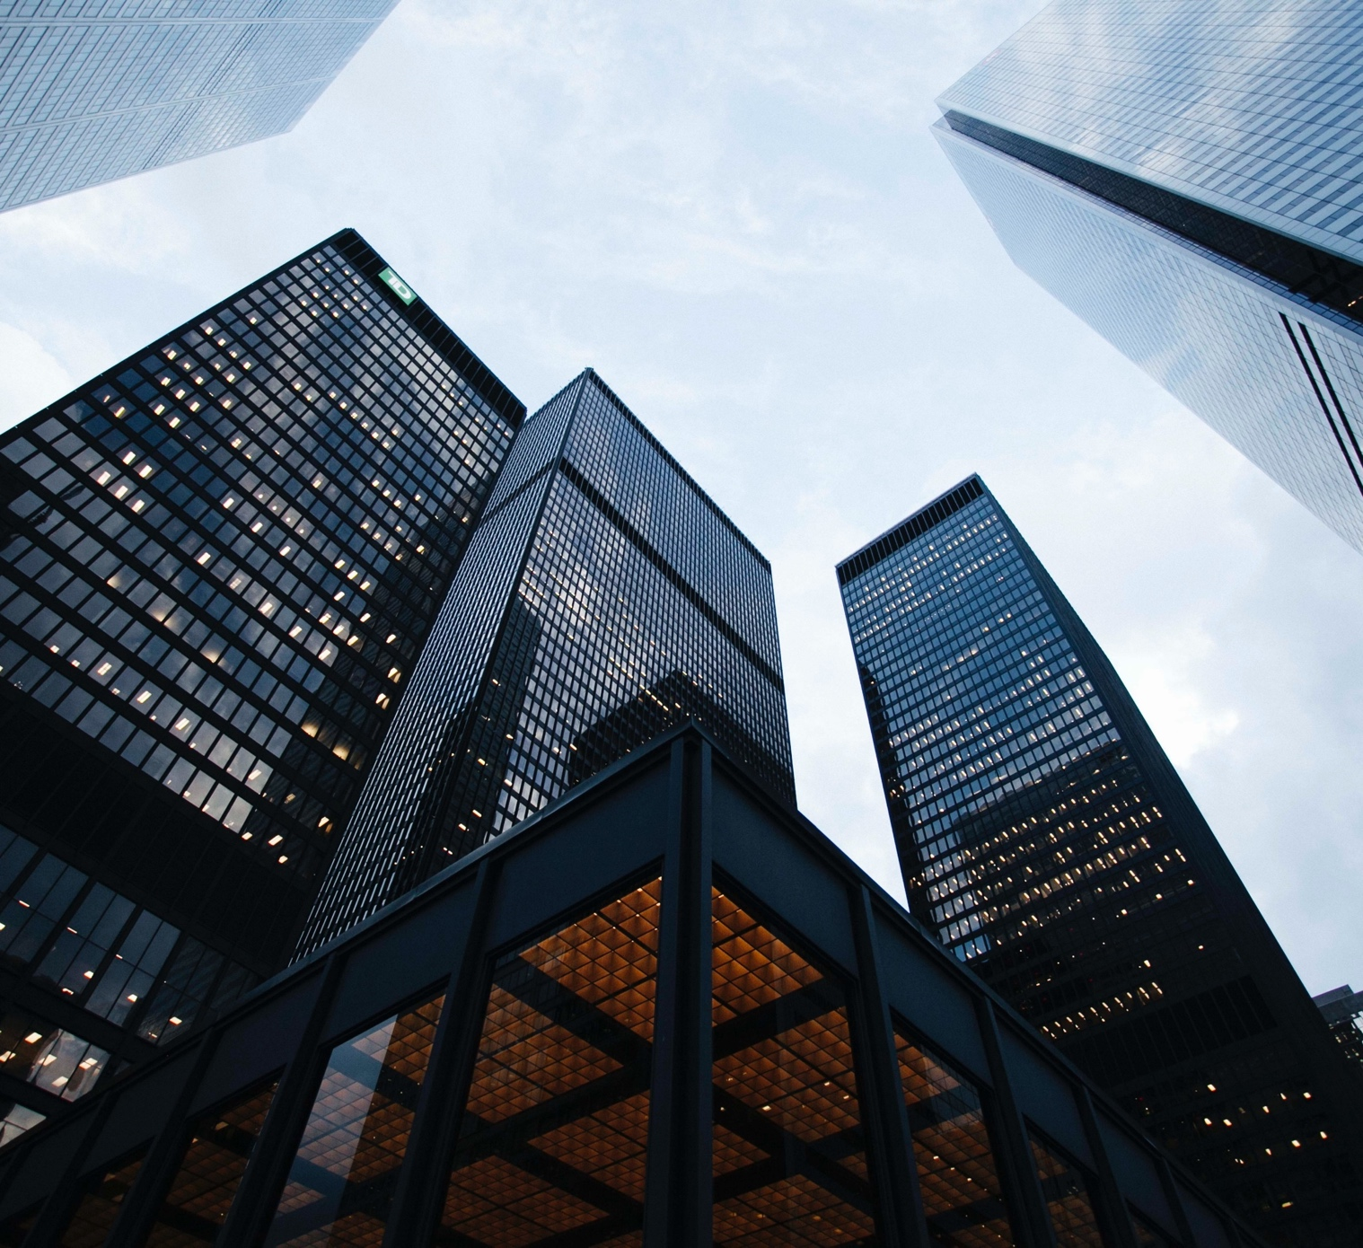
Introduction
Millions of people travel for other cities and countries every year. Not only for hobby or pleasure, but also for business too. So, for every travel, people has a lot of issues to resolve like the need of hotels, restaurants, recreation, visit the best nearby places and so on. Besides that, some problems can occur like long displacements and the fear of getting lost in unknown places.
This project have the intention to make better a travel experience using the city of Toronto as an example. The intend is to clusterize nearby locations of Toronto using hotels, cafes and other places to do this classification.

Slide 3
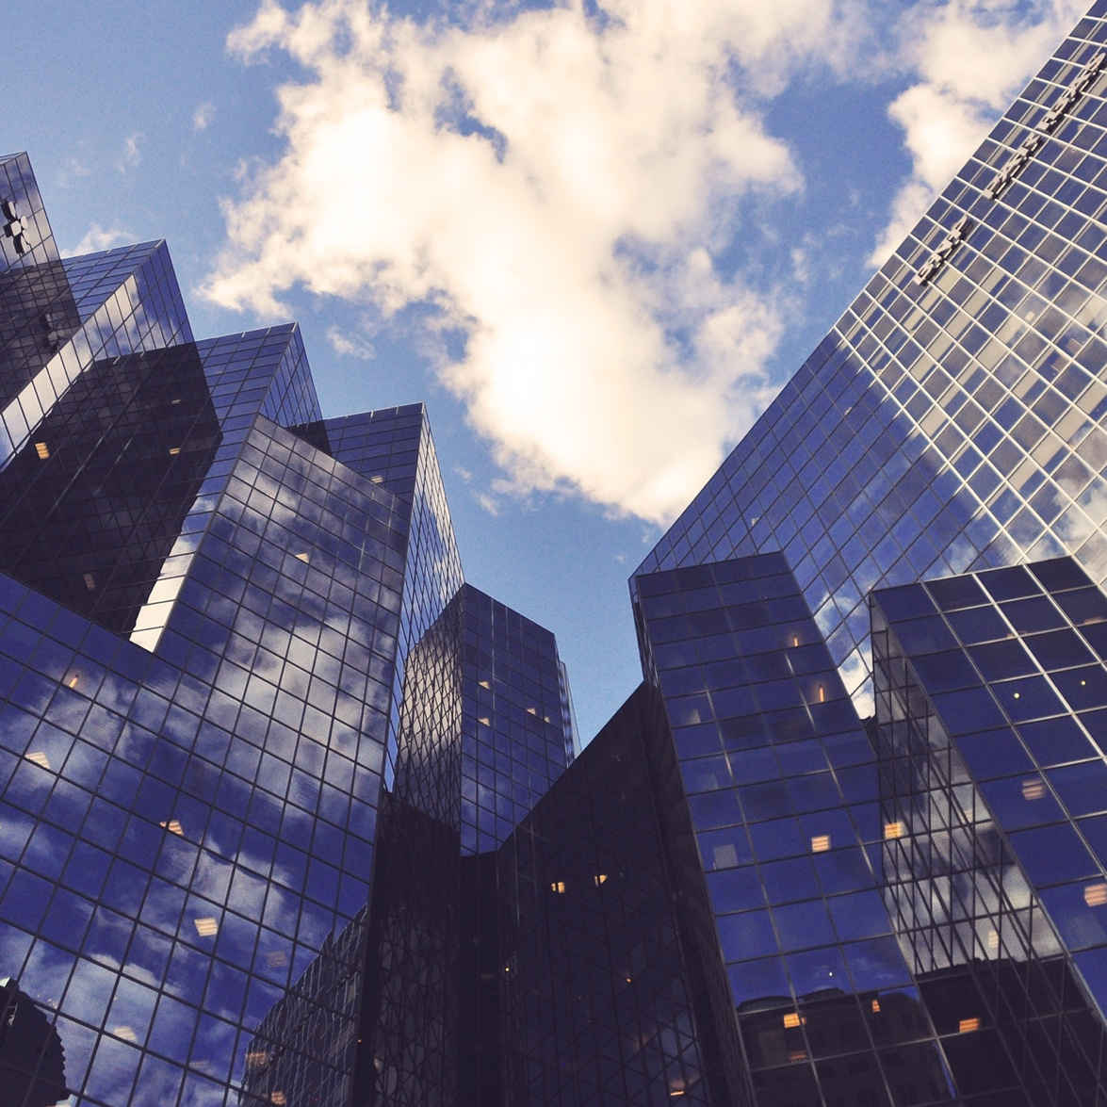
Data
As a data source will be used an integration with Foursquare, which is a technology company that uses location intelligence to build meaningful consumer experiences and business solutions. Foursquare API provides a great amount of quality data about locations like restaurants, cafe, gyms, etc. This will allow travelling people to easily decide where the best places to go when in an unknown city.
Besides that it will be necessary to collect postal codes and neighborhoods of Toronto from a Wikipedia page to use with the Foursquare locations.

Slide 4
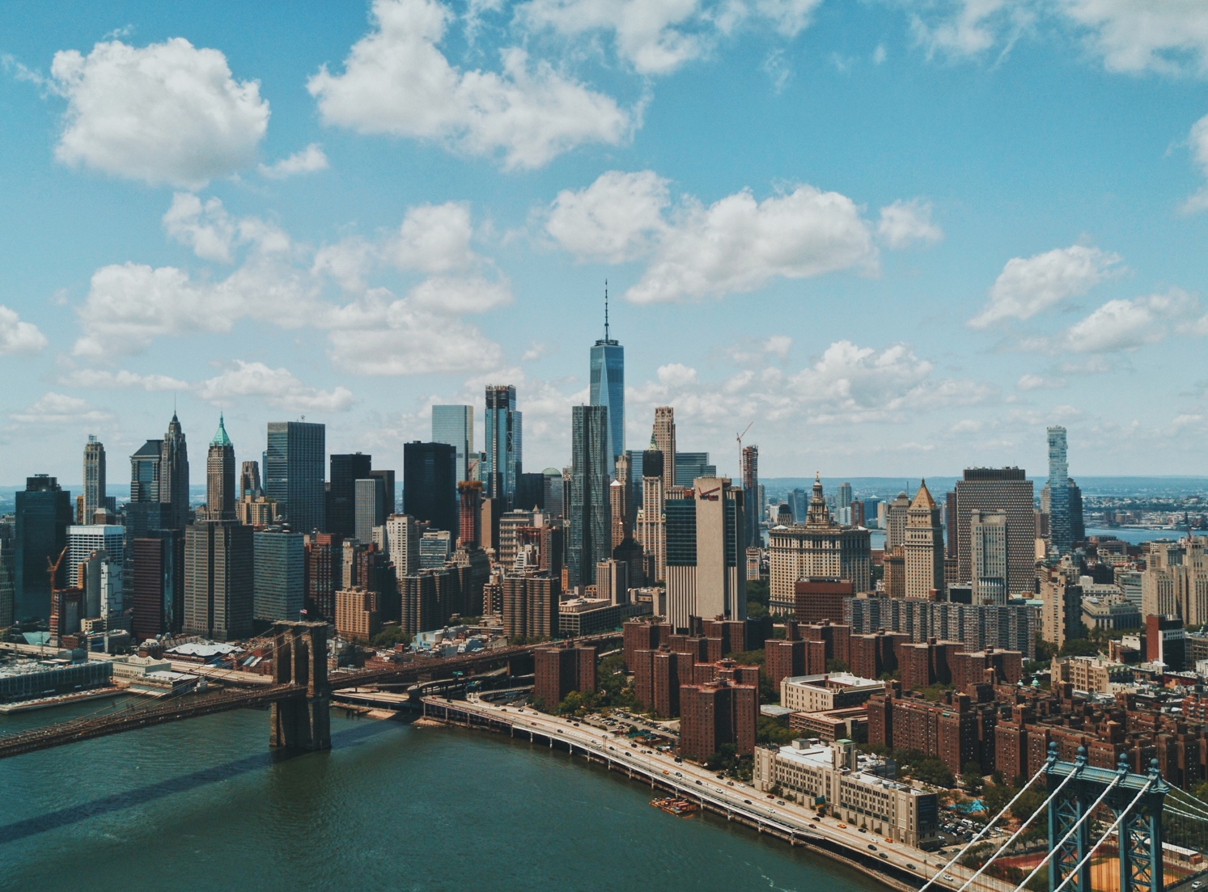
Methodology
Below are the steps of the developed methodology:
First, the geojson data for Toronto’s neighborhood is obtained from Wikipedia and transformed in a dataframe
Then, the city data is analyzed using the Foursquare API.
Lastly, each area in the city and its category is identified using clustering.

Slide 5
Results
Using data manipulation and techniques such as K-means clustering, the results in the next slides obtained common venues in the city nearby.
This information can be helpful to tourists since they can focus on what they are trying to experience most during their travelling (food, culture, sports, etc.).
These techniques also provide the clustering visualization of the city of Toronto.

Slide 6
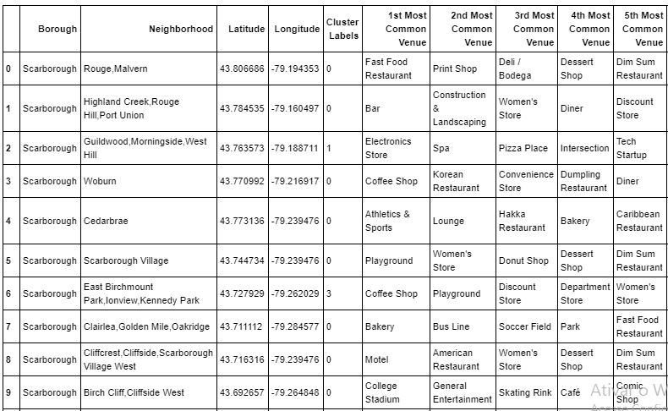
Dataframe of Common Venues in toronto

Slide 7
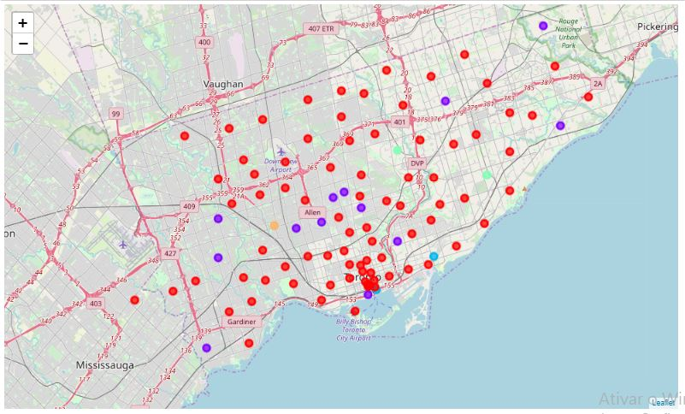
Clustering venues in Toronto city

Slide 8
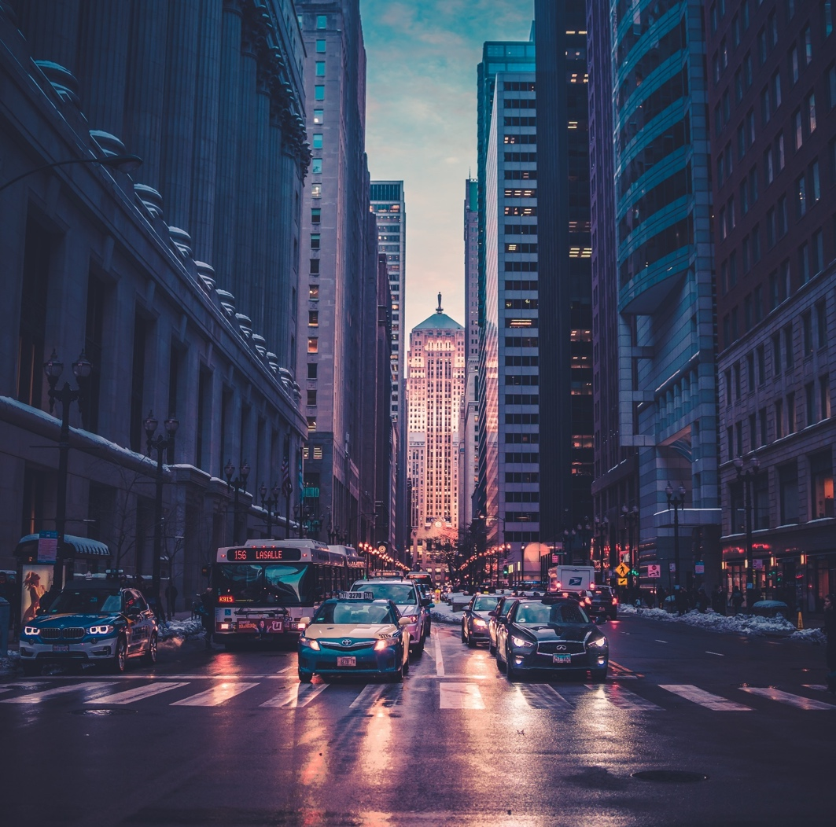


Discussion
k-means clustering is a method of vector quantization, originally from signal processing, that is popular for cluster analysis in data mining.
The most common algorithm uses an iterative refinement technique.
k-means clustering aims to partition n observations into k clusters in which each observation belongs to the cluster with the nearest mean, serving as a prototype of the cluster.
This results in a partitioning of the data space into Voronoi cells.

Slide 9
Conclusion
Using Foursquare datasets this project successfully created a way to help tourists and business travelers with all the location information handy.
With it travelers can understand a city based in clusters and familiarity places, to avoid problems such as large displacements and getting lost in an unknown city.
For instance, this project showed us that Information such as nearby places, hotels, restaurants and other venues are easily accessible using data science methodology and integrations like de Foursquare API.

Slide 10

Thanks!

